Slide 1
Computer Networking
An Overview

Slide 2
Objectives
Learners will gain a better understanding of how networks function.
Learners will better understand how this effects their classrooms.

Slide 3
What is a Network?

Slide 4
What is a Network?
A network is a group of computer systems and other computing hardware devices that are linked together through communication channels to facilitate communication and resource-sharing among a wide range of users.

Slide 5
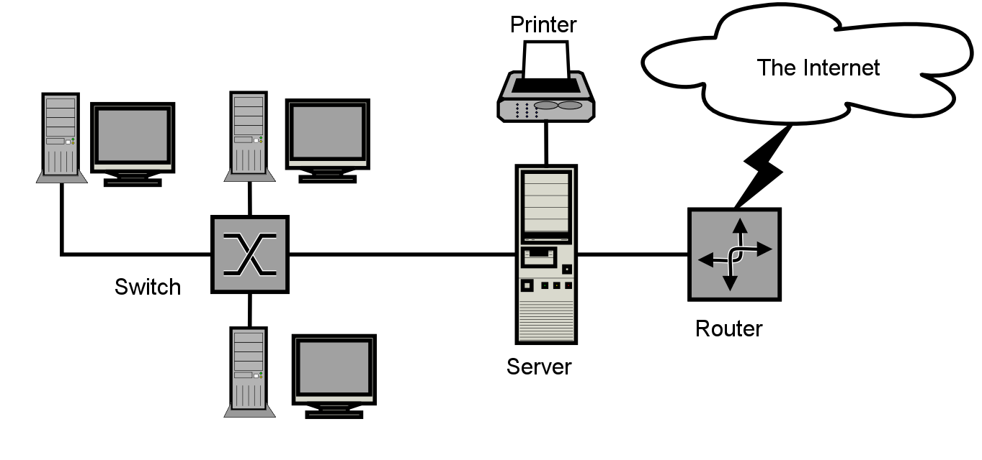
https://upload.wikimedia.org/wikipedia/en/1/12/Sample-network-diagram.png
Creative Commons

Slide 6
Types of Networks
A local area network (or LAN) is designed and implemented at the scale of a single building or office. Its primary function is the interconnection of the computing resources within a single organization.
A wide area network (or WAN) connects a single office or branch LAN to its parent organization's network and all the millions of networks that together make up the Internet.
A campus area network (or CAN) connects multiple LANs belonging to the same organization when they're in close geographic proximity.

Slide 7
Uses of a Network
Facilitate Communication (Email, Video Conferencing, etc.)
Sharing a printer or scanner (Ex: Scan from Copier to Computer)
Sharing files and programs across the district.

Slide 8
Why is this important?

Slide 9
Why is this important?
Collaboration Between Offices/Staff/Students
Technology Failures/Outages
Bandwidth Issues
No Internet Access or No Network Access
Not able to complete lessons that utilize technology.

Slide 10
Important Contacts
District Technology Director
District Technicians
Campus Technicians
Building or Department Colleagues

Slide 11
Quizlet Review of Terms
https://quizlet.com/_1zexh6

